Slide 1

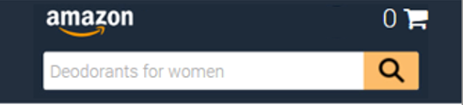
Header
Header will be full-width and will be restructured to use containers instead of big images as it is right now:
Container | PC/Tablet look | Smartphone look
Big container with an adjustable colour | Yes | Yes
Site logo (image) | Yes | Yes
Search bar (image + search button with an adjustable colour) | Yes | Yes
Deliver to (text, can we have an image here?) | Yes | No
Toolbar 1 (text, can we have an image here?) | Yes (hide if insufficient page width) | No
Toolbar 2 (text, can we have an image here?) | Yes (hide if insufficient page width) | No
Cart (text + Unicode character for cart) | Yes | Yes
1
2
3
7
4
5
6
2
7
1
3

Slide 2
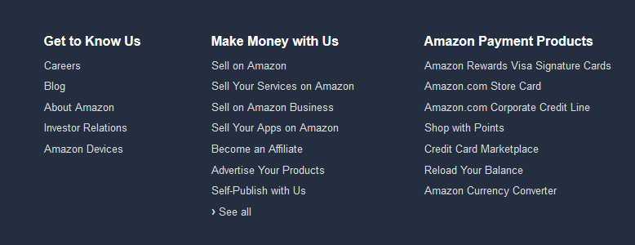
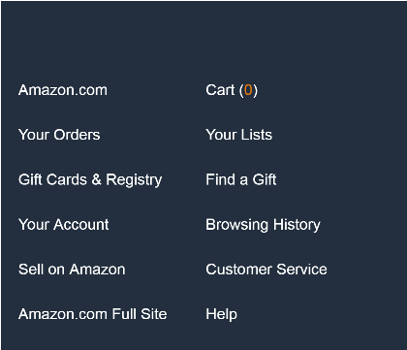
Footer
Footer will be full-width and will be restructured to use containers instead of big images as it is right now:
Back to top section with adjustable colour
Footer section with 3 columns with text for PC/Tablet and 2 columns of text for Smartphone (can we have an image here?)
1
1
Back to top
Back to top
2
2

Slide 3
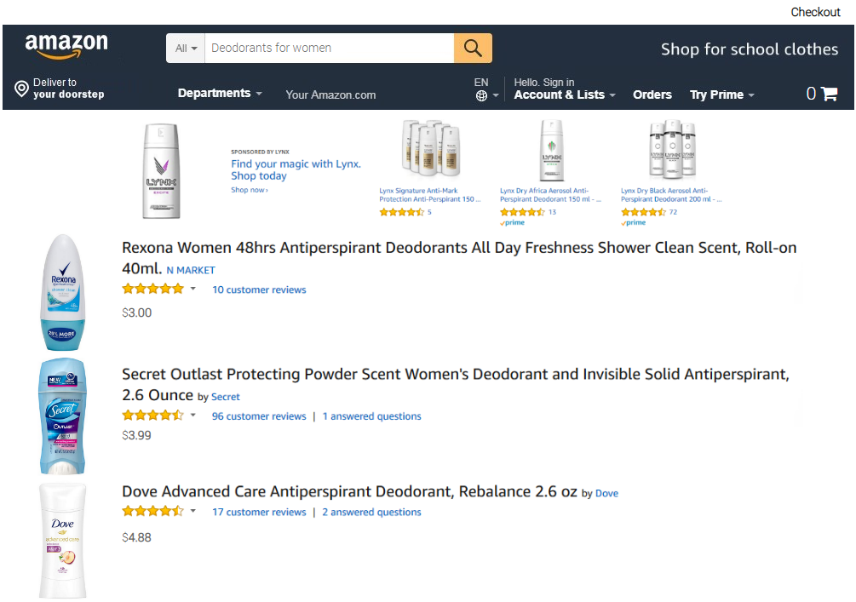
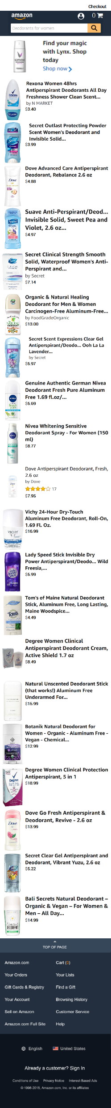
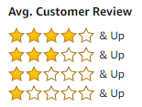
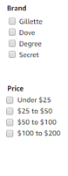
Product list
We need to introduce a grid view of the product list for PC/Tablet. Grid/row view will be set from the script, respondents will not have the option to select the view they need
We need to introduce the filtering on Number of stars, Brand, Price:
For PC/Tablet, the filter pane will be placed on the left of the simulation
For Smartphone, there will be a filter option just below the banner. When clicking on it, a filter pane will appear on top of the search results
Each of the filters can be turned on and off inside the script
Number of stars filter will be preset and could not be changed. Brand and Price will be delivered for each project and will need to allow up to 10 multi-answer positions each.
<< Back
Filter >>

Slide 4
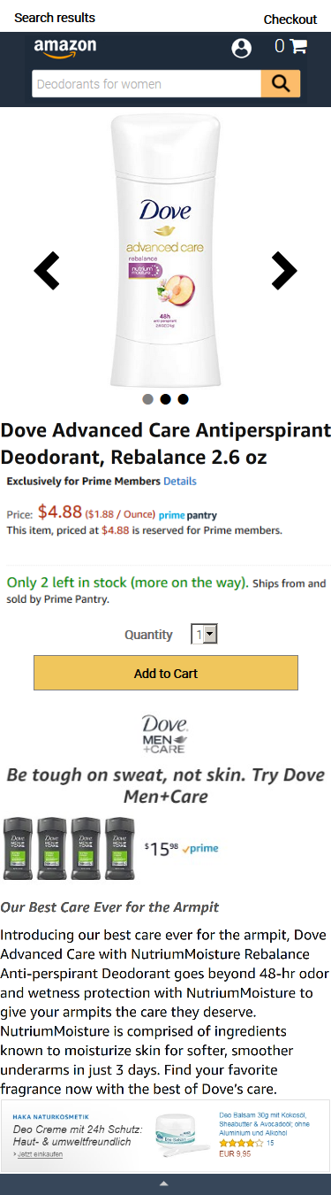
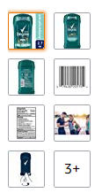

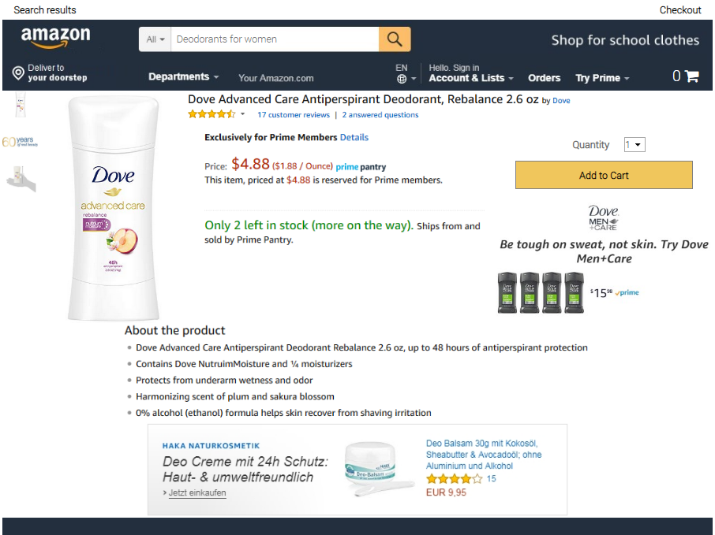
Product page
Product page layout to be updated to allow bigger product image – only on PC/Tablet. For smartphone the current layout should be kept.

